Slide 1
Transformation Methods
Penalty and Barrier methods
Study of Engineering Optimization
Adam (Xiuzhong) Chen
2010 July 9th
Ref: Georgia Institute of Technology Systems Realization Laboratory

Slide 2

Example6_1
Penalty Parameter
Penalty Term

Slide 3
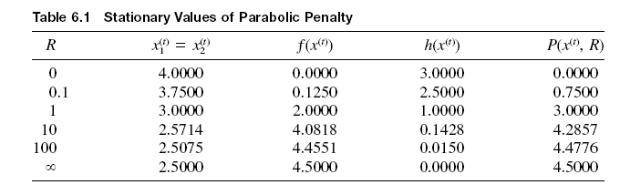
Stationary Values

Slide 4


Example6_2 Bracket operator

Slide 5

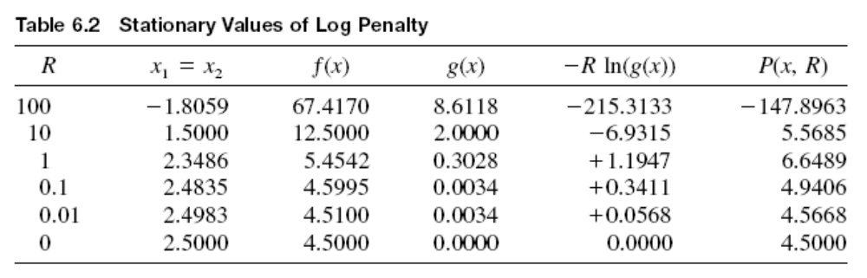
Log penalty(Barrier)

Slide 6
Penalty and Barrier Methods
General classical constrained minimization problem
minimize f(x)
subject to
g(x) ≤ 0
h(x) = 0
Penalty methods are motivated by the desire to use unconstrained optimization techniques to solve constrained problems.
This is achieved by either
adding a penalty for infeasibility and forcing the solution to feasibility and subsequent optimum, or
adding a barrier to ensure that a feasible solution never becomes infeasible.

Slide 7
Penalty Methods
Penalty methods use a mathematical function that will increase the objective for any given constrained violation.
General transformation of constrained problem into an unconstrained problem:
min P(
x, R
) = f(
x
) + Q(R,
h(
x
),g(x))
where
•
f(
x
) is the objective function of the constrained problem
•
R
is a scalar denoted as the penalty or controlling parameter
•
Q(
x,R
) is a function which imposes penalities for infeasibility
•
P(
x,R
) is the (pseudo) transformed objective

Slide 8
Sequential Penalty Transformations
Sequential Penalty Transformations are the oldest penalty methods.
Also known as Sequential Unconstrained Minimization Techniques (SUMT) based upon the work of Fiacco and McCormick, 1968.
Two major classes exist in sequential methods:
1) First class uses a sequence of infeasible points and feasibility is obtained only at the optimum. These are referred to as penalty function or exterior-point penalty function methods.
2) Second class is characterized by the property of preserving feasibility at all times. These are referred to as barrier function methods or interior-point penalty function methods.

Slide 9
What to Choose?
Some prefer barrier methods because even if they do not converge, you will still have a feasible solution.
Others prefer penalty function methods because
• You are less likely to be stuck in a feasible pocket with a local minimum.
• Penalty methods are more robust because in practice you may often have an infeasible starting point.
However, penalty functions typically require more function evaluations.
Choice becomes simple if you have equality constraints.

Slide 10
Matlab Example
To Matlab

Slide 11
Closing Remarks
Typically, you will encounter sequential approaches.
Various penalty functions Q(x) exist in the literature.
Various approaches to selecting the penalty parameter sequence exist. Simplest is to keep it constant during all iterations.

Slide 12
Thanks!

